Slide 1
Chapter 20
Introduction to Transaction Processing Concepts and Theory

Slide 2
A Banking Example
Account
ACC# | NAME | BALANCE
1001 | John | 1000
1002 | Kate | 5000
1003 | Tony | 2000
Total balance = 8000
Consistency requirement: internal money transfers should not change the total balance.
How we can respect this requirement?
Notes:
Integrity Constraints (IC): condition that must be true for any instance of the database.

Slide 3
Example
Account
ACC# | NAME | BALANCE
0001 | John | 1000
0002 | Kate | 5000
0003 | Tony | 2000
transfer $1000 from 1001 to 1003
SQL> begin
update Accounts
set Balance = Balance - 1000
where ACC# = '1001';
update Accounts
set Balance = Balance + 1000
where ACC# = '1003';
end;

Slide 4
A Banking Example
Account
ACC# | NAME | BALANCE
1001 | John | 1000
1002 | Kate | 5000
1003 | Tony | 2000
Transfer 1000 from 1001 to 1003:
Total balance = 8000
Total balance = 8000
update Account
set Balance = Balance - 1000
where Acc# = '1001';
update Account
set Balance= Balance + 1000
where Acc# = '1003';
update Account
set Balance= Balance + 1000
where Acc# = '1003';
update Account
set Balance = Balance - 1000
where Acc# = '1001';
Total balance = 8000
Total balance = 8000

Slide 5

A Banking Example
Total balance = 8000
Total balance = 8000
update Account
set Balance = Balance - 1000
where Acc# = '1001';
update Account
set Balance = Balance - 1000
where Acc# = '1001';
update Account
set Balance =Balance + 1000
where Acc# = '1003';
Total balance = 8000
Total balance = 7000
A failure during the execution of operations, may leave the database in an inconsistent state
Kind of Failures
Computer freeze
Disk write failure
Power outage

Slide 6
A Banking Example
In a concurrent execution of operations, an inconsistent state of the database may be seen or generated:
Total balance = 8000
update Account
set Balance =Balance – 1000
where Acc# = '1001';
Total balance = 7000
select sum(balance) as total from Account;
update Account
set Balance = Balance +1000
where Acc# = '1003';
Total balance = 8000

Slide 7
Database States
Consistent database state is a state of database that meets all integrity constraints
Initial
State
Possible
State
Possible
State
Possible
State
Possible
State
A transaction should make a database from on consistent state to another consistent state

Slide 8
Transactions
A transaction is a logical unit of work that contains one or more SQL statements (set of operations) and/or other programing constructs
Every transaction is assigned a unique identifier called a transaction ID.
A transaction has a beginning and an end.
The use of transactions is one of the most important ways that a database management system differs from a file system.

Slide 9
A Sample Transaction
Transaction A begins
update Account
set Balance = Balance - 1000
where Acc# = '1001';
update Account
set Balance =Balance + 1000
where Acc# = '1003';
Transaction A ends
Notes:
To illustrate the concept of a transaction, consider a banking database. When a customer transfers money from a saving account to a checking account, the transaction must consist of two separate operations:
Decrement the saving account
Increment the checking account
Oracle Database must allow for two situations.
If both SQL statements maintain the accounts in proper balance, then the effects of the transaction can be applied to the database.
If a failure such as hardware failure prevents one or two of the statements in the transaction from completing, then the database must roll back the entire transaction so that the balance of all accounts is correct.
What about insufficient funds, or invalid account number?

Slide 10
Transactions
SQL statements that can be contained in a transaction include:
query data from the database (select …)
manipulate data in the database (insert, delete, update)
trigger other transactions
automate certain processes in which database participate
respond to outside events
deliver and receive data and messages to/from outside
…
It normally contains several SQL statements (set of operations) that are executed as a whole

Slide 11
What Does a Transaction Do?
Obtain information from the database
RequestBalance transaction:
Read customer’s balance in account and output it
Update the database to reflect the occurrence of a real world event
Deposit transaction:
Update customer’s balance in account
Cause the occurrence of a real world event
Withdraw transaction:
Dispense cash (and update customer’s balance in database)

Slide 12
Main issues
Transaction specification and programming
How to coordinate different, possible concurrent user transactions in such a way that
each user has the feeling that he/she is the only user, and
is interacting in the right, intended way with the DBMS
How to process transactions in a centralized, distributed database, or multi database systems

Slide 13
What may go wrong?
System crash:
power outage
Media failure:
disk failure
Transaction failure:
arithmetic overflow
insert a tuple whose values do not conform to its schema
insert/delete/update a tuple whose values violate integrity constrains such as
primary key, foreign key, not null, beyond the range

Slide 14
Frequency of failure
Type of Failure Frequency of occurrence
transaction | 0-100 per minute
system | several per month
media | once or twice per year
How to guarantee the correctness of database
operations with hundreds of concurrent users?
Transactions

Slide 15
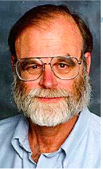
ACID Properties of Transactions
Worked in IBM on various database systems, IMS, System R, SQL/DS, DB2.
Invented transaction processing to make relational database system possible in 1976. i.e., the famous ACID properties.
In 1993, Microsoft wanted to get into relational DB market and got him on MS SQL server 7.0
Received ACM’s Turing Award in 1998 for his work on Transaction Processing when 54
Jim Gray
Jan 12, 1944
Jan 28, 2007
Atomicity
Consistency
Isolation
Durability
ACID properties

Slide 16
ACID Properties of a Transaction
Atomicity
All operations of a transaction are performed or none of them.
It prevents a transaction to leave the database in an inconsistent state.
Not true of ordinary programs. A crash could leave files partially updated on recovery.

Slide 17
Sample Transaction
Transfer 1000 from 1001 to 1003
Transaction A begins
update Account
set Balance = Balance - 1000
where Acc# = '1001';
Failure Classification
Transaction failure (including exceptional conditions such as division by zero).
System crash due to power failure or other hardware/software failures.
Disk failure such as a head crash.

Slide 18
ACID Properties of a Transaction
Consistency
A transaction must take the database from one consistent state to another consistent state.
Consistency is generally up to programmer who codes the transactions.
During the execution of a transaction the state of the database may become inconsistent.
The account table must be consistent after the operation

Slide 19
ACID Properties of a Transaction
Isolation
Each transaction appears to execute independently of other transactions that are running concurrently
The database ensures through its concurrency manager that effects of a transaction are not visible to the other concurrently running transactions until the transaction completes (commits or aborts).
Transactions seem to be serialized, one is completely executed and the next follows, even though they executed concurrently or in an interleaved way

Slide 20
Sample Concurrent Transactions
Transaction A begins
update Account
set Balance =Balance – 1000
where Acc# = '1001';
Transaction B
begins
select sum(balance) as total from Account;
Transaction B
ends
update Account
set Balance =Balance + 1000
where Acc# = '1003';
Transaction A ends
Issue: Transaction B reads an inconsistent state

Slide 21
ACID Properties of a Transaction
Durability (permanence or persistence)
After a transaction commits, the database ensures that transaction effects are permanent in spite of subsequent failures.
Not true of ordinary programs. A media failure after a program successfully terminates could cause the file system to be restored to a state that preceded the program’s execution.
If the money is transferred, then it is permanent no matter what happens later.

Slide 22
Transaction Examples
airline reservations
travel reservation
hotel reservations
banking systems
credit card processing
stock markets
supermarket checkout
...
any database systems that involves a lot of updates

Slide 23
Requirement
high availability
fast response time
thousands of concurrent users

Slide 24
Airline Reservation Systems
A customer requests a seat on an airline flight.
A reservation agent queries the database for the number of seats left on that flight. The answer to the query indicates that one seat is available
The agent requests the seat (makes it unavailable).
The agent reserves the seat (associate the customer to the seat).

Slide 25
Atomicity
Request for an available seat and reservation of that seat must both be part of the same transaction
This ensures that if a seat is marked as unavailable, there is a customer reservation associated with that seat.
If the customer decides not to reserve the seat, the transaction is canceled, the seat is no longer requested, and the seat must be marked as available once again

Slide 26
Consistency
A seat is reserved by one passenger only.
If a seat is unavailable, it must be reserved.
A transaction must update the information in the DB correctly, to ensure the above constraints.

Slide 27
Isolation
Other transactions that make the same request at the same time cannot be allowed to reserve the same seat.
That seat must be reserved by the transaction until the entire transaction is either completed or canceled
Information is not allowed to change while a running transaction depends on it

Slide 28
Durability
After the reservation (transaction) the seat stays reserved even if the computer hosting the database, crashes and restarts after the seat is reserved.

Slide 29
API for Transactions
DBMS and TP monitor provide commands for setting transaction boundaries.
Example:
begin transaction
commit
rollback
The commit command is a request
The system might commit the transaction, or it might abort it for one of the reasons on the previous slide
The rollback command is always satisfied

Slide 30
Simplification
read_item(X)
read a database item named X into a program variable X
write_item(X)
write the value of program variable X into the database
A transaction can be represented as a sequence of read_item and write_item

Slide 31
Simplified Example Transaction
SQL> begin
update Accounts
set Balance=Balance + 1000
where ACC# = '1001';
update Accounts
set Balance = Balance - 1000
where ACC# ='0003';
end;
read_item(balance); //the tuple for acc #0001
balance = balance + 1000;
write_item(balance);
read_item(balance); //the tuple for acc #0002
balance = balance - 1000;
write_item(balance);
Account
ACC# | NAME | BALANCE
1001 | John | 1000
1002 | Kate | 5000
1003 | Tony | 2000

Slide 32
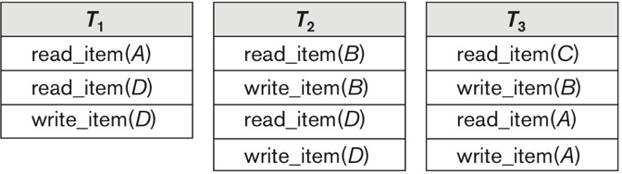
Example Transactions
Notes:
Figure 22.1a

Slide 33
Concurrent Execution
begin trans
..
op_{1,1}
..
op_{1,2}
..
commit
Client 1
sequence of db
operations output by T₁
T₁
op_{1,1} op_{1.2}
Transaction
Processing
Monitor
DBMS
SERVER
local computation
begin trans
..
op_{2,1}
..
op_{2,2}
..
commit
Client 2
op_{1,1} op_{2,1} op_{2.2} op_{1.2}
T₂
op_{2,1} op_{2.2}
interleaved sequence of db
operations input to DBMS
local variables

Slide 34
Schedules of Transactions
A schedule S of n transactions T₁, ..., T_{n} is an ordering of the operations of the transactions subject to the constraint that,.for each transaction T_{i} in S, the operations of T_{i} in S must appear in the same order in which they occur in Ti.
T₁: r₁(X); w₁(X); r₁(Y); w₁(Y);
T₂: r₂(X); w₂(X);
S₂: r₁(X); r₂(X); w₁(X), r₁(Y); w₂(X); w₁(Y)
TPC
S₂: r₁(X); w₁(X); r₂₍X), w₂(X); r₁(Y); w₁(Y);

Slide 35
Conflict operations
They belong to different transactions
They access the same item X
At least one of the operation is write_item(X)

Slide 36
Complete schedule
A schedule S of n transactions T₁, ..., T_{n} is complete schedule if the following conditions hold:
The operations in S are exactly those operations in T₁, ..., T_{n}
Any pair of operations from the same transaction T_{i} keep their order in S
For any two conflicting operations, one of the two must occur before the other in the schedule

Slide 37
Kinds of schedules
Serial schedules
One transaction after another
Non-serial schedules
Operations are interleaved
Serializable schedules
A schedule S of n transactions is serializable if it is equivalent to some serial schedule of the same n transactions

Slide 38
Chapter 21
Concurrency Control Techniques

Slide 39
What does it mean?
multiple users access the database at the same time which means multiple transactions access the database at the same time
Solution
objects to be updated should be locked so that the result can be seen after the transaction committed or rollbacked.
Two kinds of locks:
X locks (exclusive lock) write
S locks (share lock) read

Slide 40
Locking
if A holds an X lock on O and B requests a lock (X,S), then put B into a waiting queue.
if A holds an S lock on O, B requests an S lock,
then grant B the S lock.
if A holds an S lock on O, B requests an X lock,
then put B into a waiting queue.
Problem with locks
Deadlocks
Solution
detect and break

Slide 41
Server Processes
DBMS daemon (server)
communicates with client program (SQLPLUS) and updates the DB buffers in Memory also writes log buffers in Memory
DBW (DB writer) daemon
transfers data from the DBMS area to DB buffers
LGRW (log writer) daemon
transfers data from the DBMS area to log buffers
CKPT (checkpoint) daemon
perform checkpoint function

Slide 42
Chapter 22
Database Recovery Techniques

Slide 43
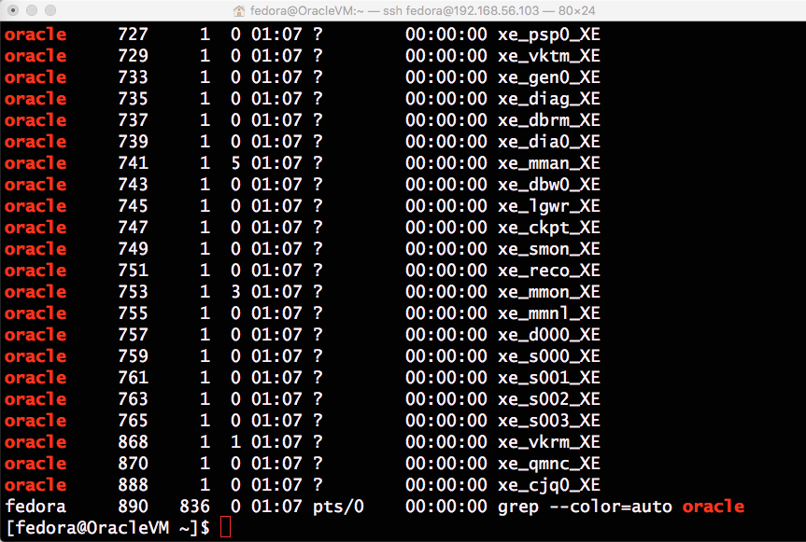
DBMS Processes (ps –ef |grep oracle)
Notes:
DBRM
Database Resource Manager Process
DBWn
Database Writer Process
Writes modified blocks from the database buffer cache to the data files
LGWR
Log Writer Process
Writes redo entries to the online redo log
CKPT
Checkpoint Process
Signals DBWn at checkpoints and updates all the data files and control files of the database to indicate the most recent checkpoint

Slide 44
DBMS internal
When updates DB
the memory buffers (DB and LOG) are updated not the database files
When commit,
DB and LOG buffers are written to DB and LOG files
all open cursors are closed and all DB positioning is lost
all record locks are released

Slide 45

System Failure
Interaction with OS:
DBMS daemon DBW daemon
Transaction －> memory buffer－> disk
commit
write doesn't means write to disk directly as this is too costly (slow)
it is done later by DBW (storage manager)
time

Slide 46
Implementing ACID properties
Use write-a-head system log during normal execution of transactions for use during crash recovery
Log must be physically written before database operations
Records the details of all operations to the database:
1. the operation
2. the valued before and after the transaction
When commit, the log file records the corresponding information
When rollback, the log file is used to restore the original value

Slide 47
Type of entries in the system log
[start_transaction, T#]
[write_item, T#, X, old_value, new_value]
[read_item, T#, X]
[commit, T#]
[abort, T#]
[checkpoint]

Slide 48
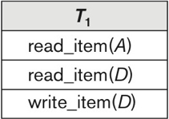
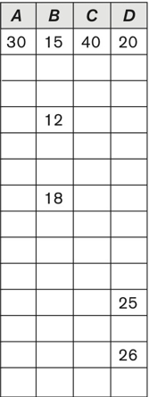
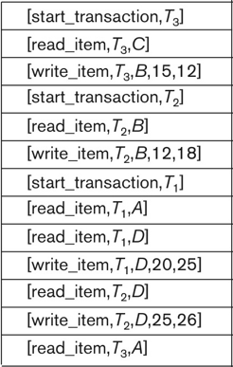
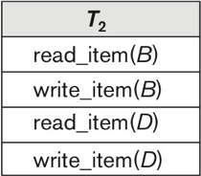
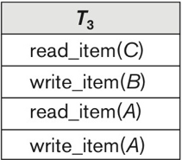
Examples of Transaction Execution
time
Notes:
Figure 22.1b

Slide 49
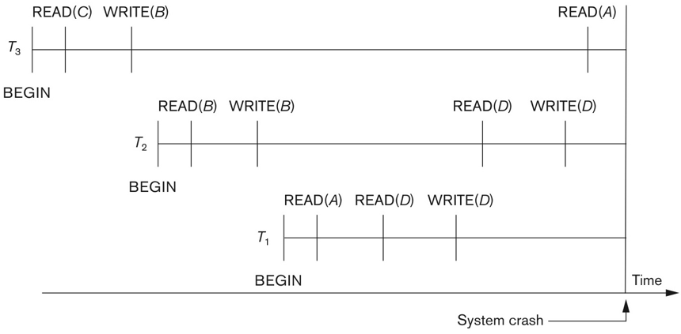
System Crash
Notes:
Figure 22.1c Illustrating cascading rollback (a process that never occurs in strict or cascadeless schedules). Operations before the crash.

Slide 50
Durability
Active: the transaction stays in this state while it is executing.
Partially committed: after the final statement has been executed.
Failed: after the discovery that normal execution can no longer proceed.
Aborted: after the transaction has been rolled back and the database restored to its state prior to the start of the transaction. It is followed by restarting the transaction or killing it.
Committed: after successful completion.

Slide 51
Reasons for Abort
Transaction requests to roll back.
Transaction aborted by database system:
Execution did not maintain database consistency (integrity constraint is violated)
Resources not available (deadlock)
System crash or disk failure.

Slide 52
How to use log to deal with failures
Soft crash (power outage)
affect all transactions but not the database
What should we do?
Not committed transactions must be undone
Committed transactions must be redone, to make them permanent as they are in buffer but on disk

Slide 53
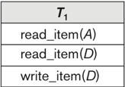
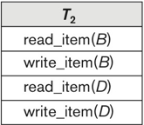
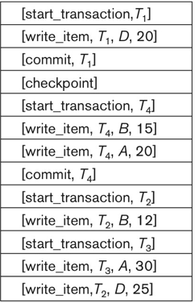
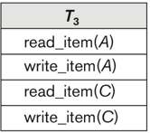
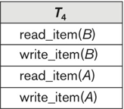
Examples of Transaction Execution
System crash
Notes:
Figure 22.3 An example of recovery using deferred update with concurrent transactions. (a) The READ and WRITE operations of four transactions. (b) System log at the point of crash.

Slide 54
States for Transaction Execution
Partially committed
committed
active
failed
aborted

Slide 55
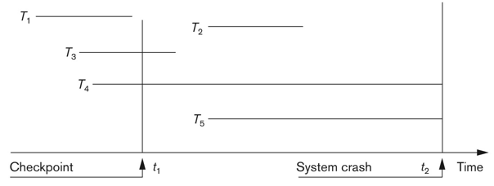
Example
Figure 22.2
Recovery timeline
T1 is committed before the checkpoint t₁
T₂, T₃ are committed after checkpoint t₁
T₃ is redone from checkpoint to the end
T₂ is redone completely
T₄, T₅ are not committed after checkpoint t₁
T₄ should be undone from its beginning to checkpoint
T₅ is after the checkpoint so it is never written to the database and nothing needs to be done.
Notes:
Figure 22.2

